Slide 1
CodeBig
Spark Ideas

Slide 2




CodeBig Team
Sejal Chauhan
University of Wisconsin-Madison
Lyujia Zhang (Chloe)
Columbia University in the City of New York
Shubhi Rani
Stony Brook University
Wan Chen
University of Illinois at Urbana Champaign

Slide 3
Curriculum Outline
What is Spark?
Architecture Overview
Spark Libraries
SQL Demo
MLlib Demo
Performance Tips and Debugging
Amazing Applications
On-going and Future Work
References
Summary

Slide 4
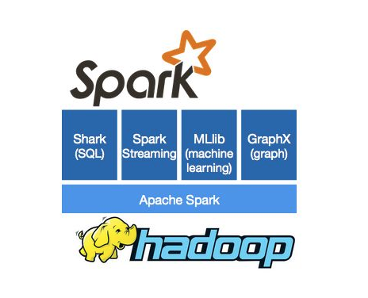
What is Spark?
Apache Spark™ is a fast and general engine for large-scale data processing
DAG Execution Engine
Cyclic Dataflow
In-memory caching and faster execution
Using RDD(Resilient Distributed Datasets)
Supports applications written in
Java
Python
Scala
Over 80 operators to facilitate parallel apps
http://spark.apache.org/images/spark-logo-trademark.png

Slide 5
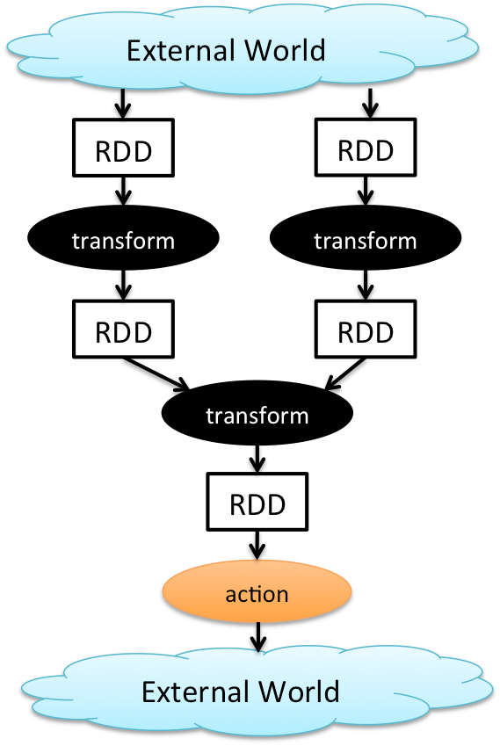
Programming Paradigm
Distribute a large data set on multiple nodes
Map functions row by row
Group data by a key
Perform aggregate operations
http://1.bp.blogspot.com/-n4yvEQU--bQ/VHktMl5yzSI/AAAAAAAABI8/rmDb69CpgUE/s1600/p1.png

Slide 6
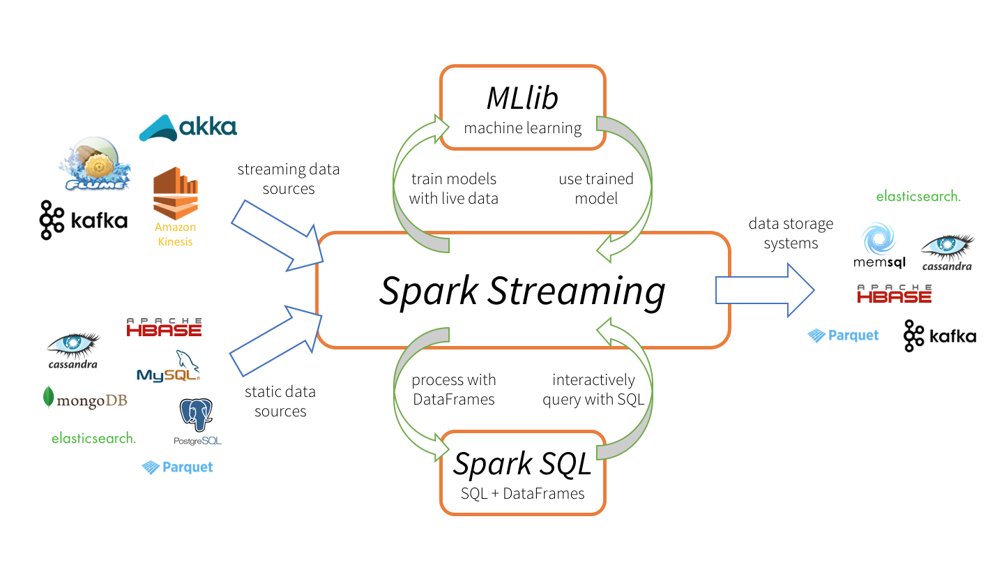
Spark: Tying it all together
http://2s7gjr373w3x22jf92z99mgm5w-wpengine.netdna-ssl.com/wp-content/uploads/2015/11/spark-streaming-datanami.png

Slide 7
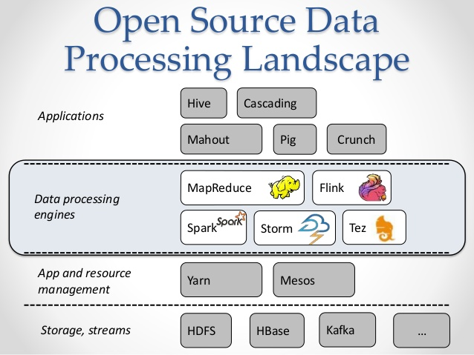
Architecture Overview
Components:
Applications
Hive
Data Processing Engines
Spark
App and resource management
YARN
https://media.licdn.com/mpr/mpr/shrinknp_800_800/AAEAAQAAAAAAAAbEAAAAJDMwMDUxZTkwLTA1MjMtNDkxZS05NTU1LTA2NjNjOGQxYWIwNg.jpg

Slide 8
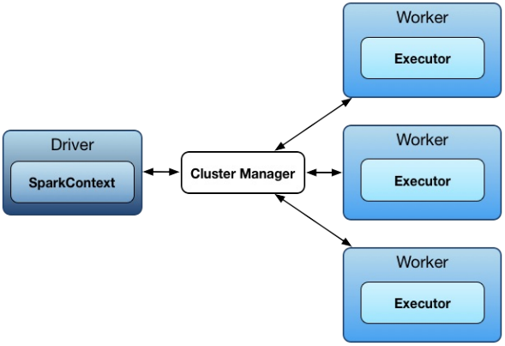
Spark Architecture (master/slave architecture)
SparkEnv
TaskScheduler
DAGScheduler
Notes:
Driver talks to master (single coordinator manages workers).
Driver and the executors run in their own Java processes, can be run on same (horizontal cluster) or separate machines (vertical cluster).
Driver splits a Spark application into tasks and schedules them to run on executors.
A driver coordinates workers and overall execution of tasks.
Master is a running Spark instance that connects to a cluster manager for resources.
The master acquires cluster nodes to run executors.
Workers/slaves are running Spark instances where executors live to execute tasks. (compute nodes)

Slide 9
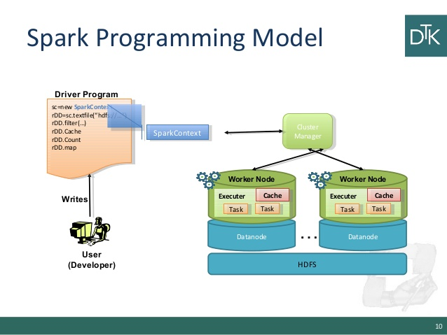
Spark Performance
Low-level Optimizations
DAG( directed acyclic graph) of computation stages
Lazy evaluation(Postpone any processing until really required for action)
Low-latency iterative workloads
Cache intermediate data in memory for faster model building and training
http://image.slidesharecdn.com/6-150108024847-conversion-gate02/95/scala-and-spark-10-638.jpg?cb=1420685361

Slide 10
Why Spark
Input, output, and intermediate data in-memory Resilient Distributed Datasets (RDD):
fundamental data structure
Immutable distributed collection of objects.
Each dataset in RDD is divided into logical partitions
Computed on different nodes of the cluster.
Transformation:
Map - rdd.map for adding a constant for each item
Filter - rdd.filter for items satisfying a condition
ReduceByKey - rdd.reduceByKey for reduction within a group using a key
Action:
Collect - rdd.collect for printing items
Reduce - rdd.reduce for summation/mean
Efficient query plans for data transformations
Notes:
•without I/O cost, boosting performance

Slide 11
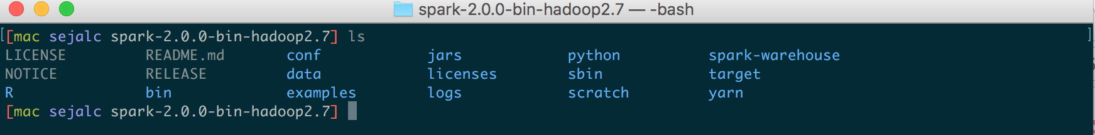
Applications
•Batch Processing
•Streaming Analytics
•MLlib: Machine Learning (SparkR uses this library)
•GraphX: Graph Databases
•Ad hoc queries

Slide 12
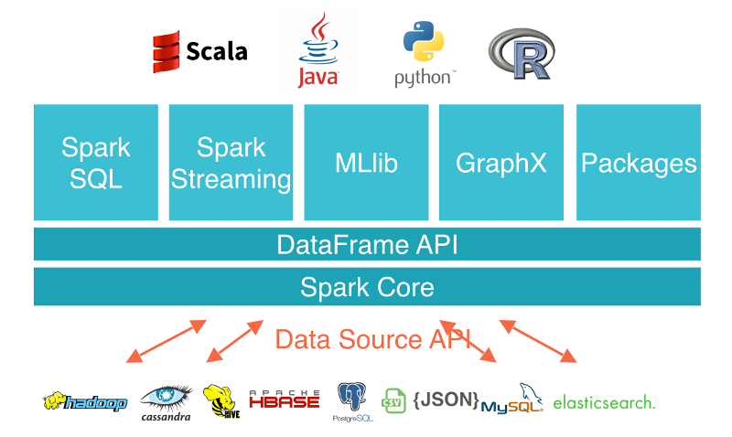
Spark Application Libraries
https://weidongzhou.files.wordpress.com/2015/09/spark_engine.jpg

Slide 13
How application is executed in Spark
Create RDD graph
I.e. DAG (directed acyclic graph) of RDDs to represent entire computation
Create stage graph
I.e. a DAG of stages that is a logical execution plan based on the RDD graph
Stages are created by breaking the RDD graph at shuttle boundaries
Based on the plan, schedule and execute tasks on workers.

Slide 14
Execution Engines, Resource Negotiators
Execution engines
Apache Spark™ is a fast and general engine for large-scale data processing.
Resource Negotiators
E.g. Yarn, Mesos
Like a load balancer to see which resources (CPU, memory) is available.

Slide 15
Schedulers
DAGScheduler
Scheduling layer of Apache Spark that implements stage-oriented scheduling
Computes an execution DAG for a job
Determines the preferred locations to run each task on
Handles failure due to shuffle output files being lost
Runs stages on topological order
Task Scheduler
Schedules tasks for a single Spark application according to scheduling mode
Gets sets of tasks submitted to it from DAGScheduler for each stage
Responsible for sending the tasks to the cluster, running, retrying

Slide 16
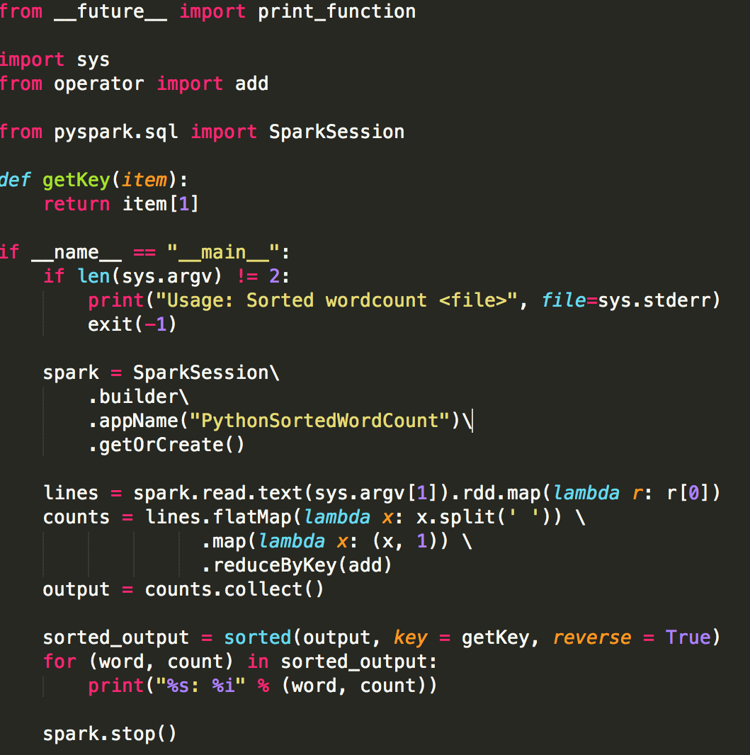

Spark Demo
Three step Sorted Word Count:
Map the words
Reduce
Collect the words in the sorted manner

Slide 17
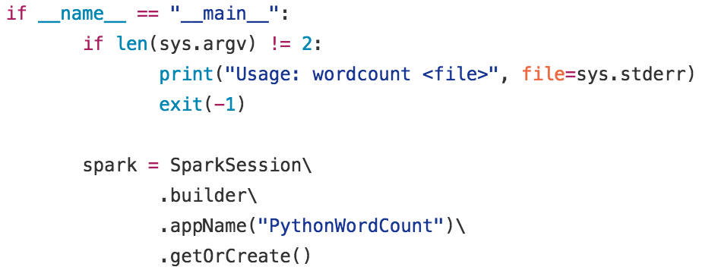

Sorted Word Count Template
…..insert code here….

Slide 18
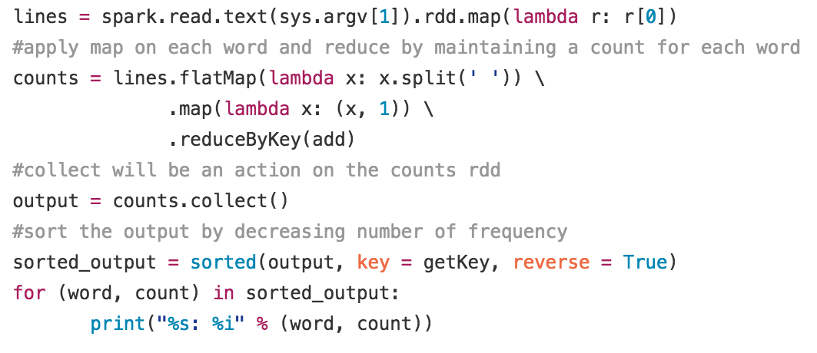
Sorted Word Count Solution

Slide 19
SQL-based
Spark SQL is a Spark module for structured data processing.
ways to interact with Spark SQL: SQL and the Dataset API
When computing a result the same execution engine is used, independent of which API/language you are using to express the computation.

Slide 20
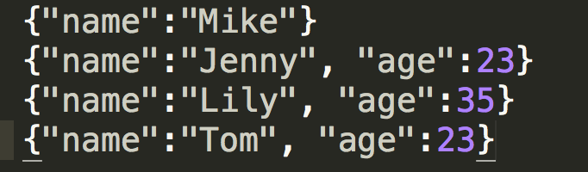
SQL Example
Given a dataset of employees list with their names and ages, do queries on it with Spark SQL as following:
Print out the dataframe generated by reading the json file
Print out attribute types by printing schema
Show all names listed in the dataset
Count number of employees at each age
Show all names of employees with age younger than 30
Employee.json
basic_dataframe.py (Github link)
https://github.com/CodeChix-OpenSource/CodeChix-Technical-Curriculums/tree/master/VMware-CodeHouse/CodeBig/src/basic_daataframe.py

Slide 21
SQL Exercise
Create your own dataset in json/txt format, reading it in and write it as parquet file saved under Spark directory, and then create a view from reading the parquet file you just created, lastly do 5 interesting queries on the SQL view.
What is parquet?
Parquet is a columnar format that is supported by many other data processing systems. Spark SQL provides support for both reading and writing Parquet files that automatically preserves the schema of the original data.
Solution link
https://github.com/CodeChix-OpenSource/CodeChix-Technical-Curriculums/tree/master/VMware-CodeHouse/CodeBig/src/SQL_parquet_solution.py

Slide 22
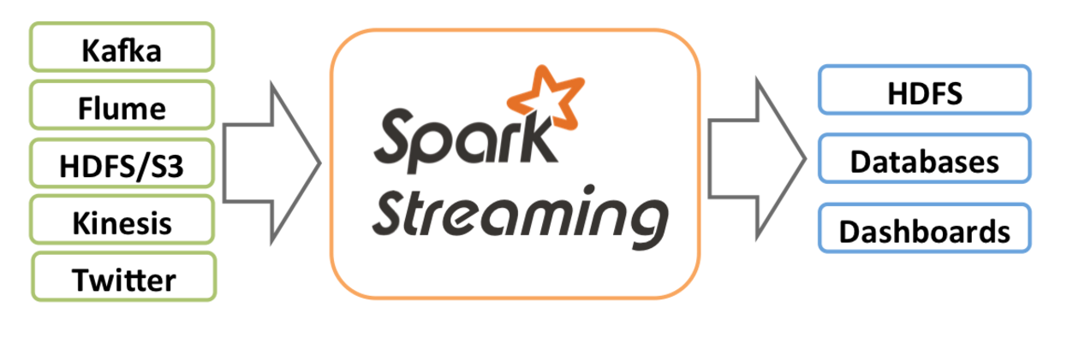
Spark Streaming

Slide 23
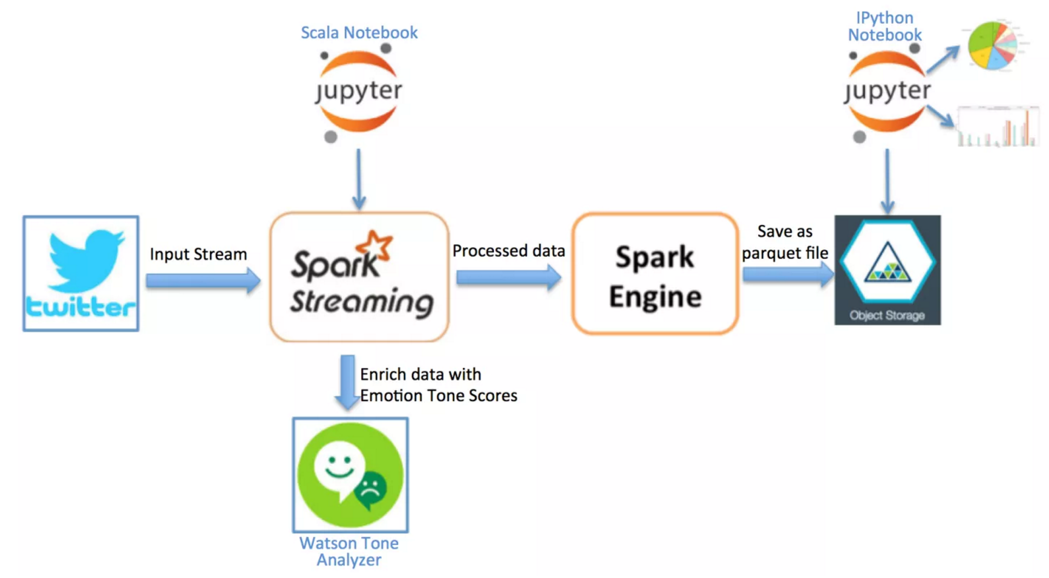
Stream Analytics
Spark Streaming example from IBM’s project - Sentiment Analysis of Twitter Hashtags
https://developer.ibm.com/clouddataservices/sentiment-analysis-of-twitter-hashtags/

Slide 24
Machine Learning
MLlib is Apache Spark’s scalable machine learning library
MLlib incorporates following algorithms
Classification : Logistic regression, Naive Bayes
Regression : Linear Regression
Collaborative filtering : Alternative Least Sequence
Clustering: K-means
Decomposition: SVD, PCA
Data scientists can use both Python and R to use Spark

Slide 25
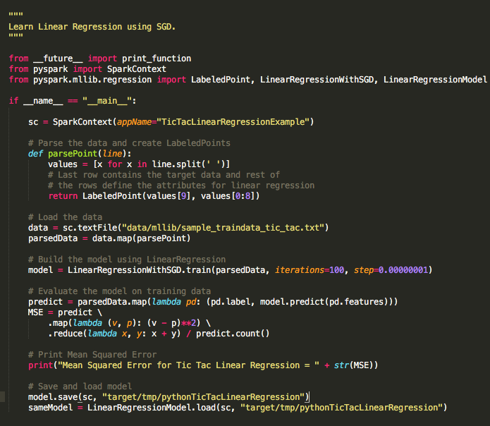
Tic Tac Linear Regression Algorithm

Slide 26
Tic Tac Linear Regression Algorithm

Slide 27
Tic Tac Linear Regression Algorithm

Slide 28
Tic Tac Linear Regression Algorithm

Slide 29
Demo for Tic Tac
You can find demo link for Tic Tac Linear regression python program
YouTube
https://youtu.be/rmlyCOtpew8
Github Link
GitHub
https://github.com/CodeChix-OpenSource/CodeChix-Technical-Curriculums/tree/master/VMware-CodeHouse/CodeBig/src/tic_tac_linear_reg.py

Slide 30
Exercise
Explore new machine learning algorithm, SVD to run the Tic Tac program.

Slide 31
Debugging and Performance Tips
Tips:
Always operate using ubuntu user by default. Use root permissions only when needed(e.g. to modify /etc/hosts, /etc/mysql/my.cnf).
Empty the buffers cache before any of your experiment run. You can run: sudo sh -c "sync; echo 3 > /proc/sys/vm/drop_caches" on each slave VM.
Error: Unable to convert Spark RDD to Schema RDD
Example code written in object Temp: people.registerTempTable("people")
No TypeTag available for Person at the line people.registerTempTable("people")
Resolved by Jira: https://issues.apache.org/jira/browse/SPARK-4842

Slide 32
Things we didn’t cover
GraphX for data stream processing
Collaborative Filtering: ALS(Alternating least squares)
Multi clustering across different systems

Slide 33
Where do I apply this amazing stuff?
Movie Recommendation - MLlib Collaborative Filtering
Flight Scheduling - MLlib
Data Streaming - Amazon product recommendation
Sparkling Water - uses SparkR + H2O frame

Slide 34
References
https://spark.apache.org/downloads.html
http://genomegeek.blogspot.com/2014/11/how-to-install-apache-spark-on-mac-os-x.html
https://spark.apache.org/docs/latest/graphx-programming-guide.html
https://aws.amazon.com/emr/details/spark/
https://aws.amazon.com/blogs/aws/new-apache-spark-on-amazon-emr/
http://stackoverflow.com/questions/27440377/unable-to-convert-spark-rdd-to-schema-rdd
https://rpubs.com/wendyu/sparkr
http://spark.apache.org/docs/latest/mllib-collaborative-filtering.html
https://spark.apache.org/docs/1.2.0/programming-guide.html

Slide 35
Summary
Thank you for attending the brief session on Spark.
There are humongous real life problems that can be solved much faster using Spark
Spark Ideas and Code Big!!

